Slide 1
TREASURE HUNT…. UNLEASH “THE INSIDE YOU!”

Slide 2
WHAT ARE YOUR TALENTS?
Everyone has talents, even if they don’t realize it. A talent is something that comes naturally to someone. For instance, you may have the ability to draw and paint, or play a musical instrument.
Talents can lie in any area, and they can help you to become more successful in your career. Don’t simply rely on your educational background to get you into the career of your dreams.
Learn what your hidden talents, then refine them and make them work for you.

Slide 3
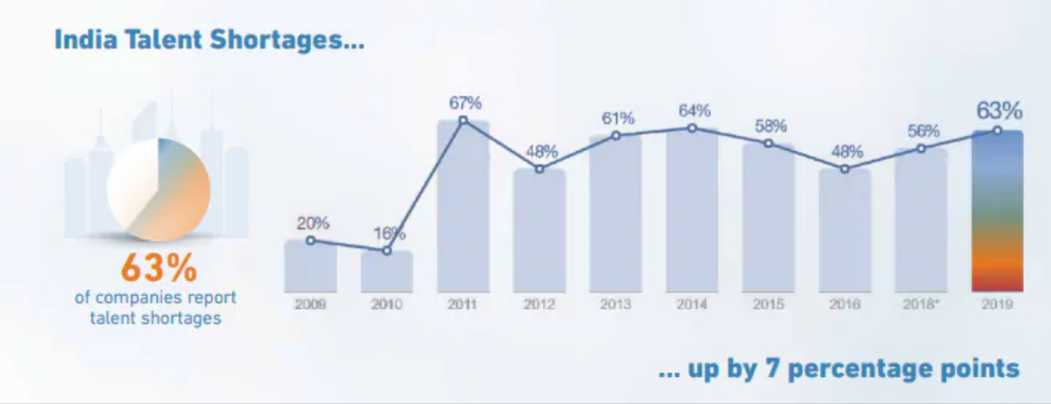
NEED:
Population of India is projected close to 1.38 billion or 1,380 million in 2020.
India faces a talent shortage of 63 percent, higher than the global average, according to a new research report.
The research report on Talent Shortage 2020 shows that globally 54 percent reported talent shortages almost doubled as compared to a decade ago.

Slide 4
STATISTICS:
The report says that, while 73 percent of workers like their jobs, 50 percent of people between 18-24 years are interested in finding a new one. The number is even higher for those between 25-34 years (60 percent).
According to the report, the top-ten most in-demand roles in 2019 are trending year over year. These include sales representatives, cybersecurity experts, nurses, teachers, skilled traders, hotel workers and mechanical engineers among others.
The report said that 80 percent of them were also in short supply in 2018 in India. Healthcare professionals in the top ten reflecting an aging population.

Slide 5
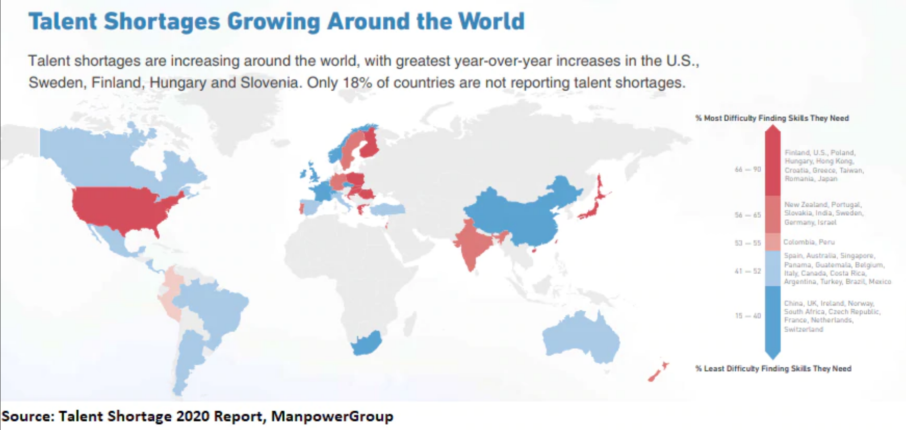

Slide 6
DIFFICULTIES:
SELF-DOUBT
MINDSET
CONFUSION
HESITANCY
INDECISION
INSECURITY
LACK OF CONFIDENCE

Slide 7
CHALLENGES DEEP-DIVE:
Challenge 1
Challenge 2
Challenge 3
Confusion:
You do many things, but get bothered by thinking that much more needs to be done. You tell yourself that this is not enough. You get confused many times and your mind forces you to think that you are in a wrong profession, or may be with wrong people or in wrong environment.
Knowing One’s Talent:
Not realizing your true potential is probably one of the biggest regret. As people get older realizing that you could’ve been more is one of the biggest emotional upheavals you can experience in your life.
Where to Start:
Self Improvement always need a good mentor who can guide through all clouds of blurred thought, self doubts and and myths.

Slide 8
IMPLEMENTATION:
A website will be created in which we will provide the candidate with a series of tests which will contain questions from different topics (apart from working area) which candidate has to opt.
We will assess those tests. Based on the results, we will provide the candidate with some suggestions, project or task in the topic he excelled. And he will also join the community of people with same area of interest.
By following this procedure, candidate will be able to find his area of interest. If he wants to discover more he can even suggest us for including more areas.

Slide 9
FEATURES FOR REVEALING “THE INSIDE YOU”
User Registration | User should be able to register to application using Facebook, LinkedIn account, G-mail, Phone number. so that user can get access to the application
User Authentication | User should be able to authenticate himself through single sign in, or OTP or verification code which is sent to the mail id by “Treasure Hunt”. so that user can get access to the application
Dashboard | A user will be displayed with the series of information which provide users a glance awareness about the application.
Personality Quiz | User will be able to take the Personality test in order to unleash his/her hidden Talents. Once the test is attempted the website provides the complete picture of the Report .
Progress | User will be able to know his strengths & weakness’s. Now he can decide for himself. Now he can step out of his comfort zone and can enhance his talents
Bookmarks & Events | User can even bookmark the events, which he is interested in for future use. At the same time he is also notified with the related events.
Community | Here a community can be formed where they can participate in groups and can help one another to reach one’s target or dream.

Slide 10
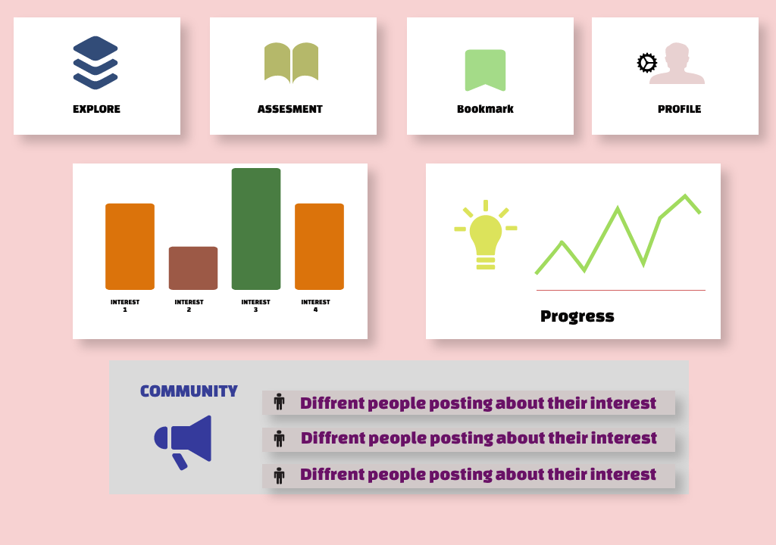

Slide 11
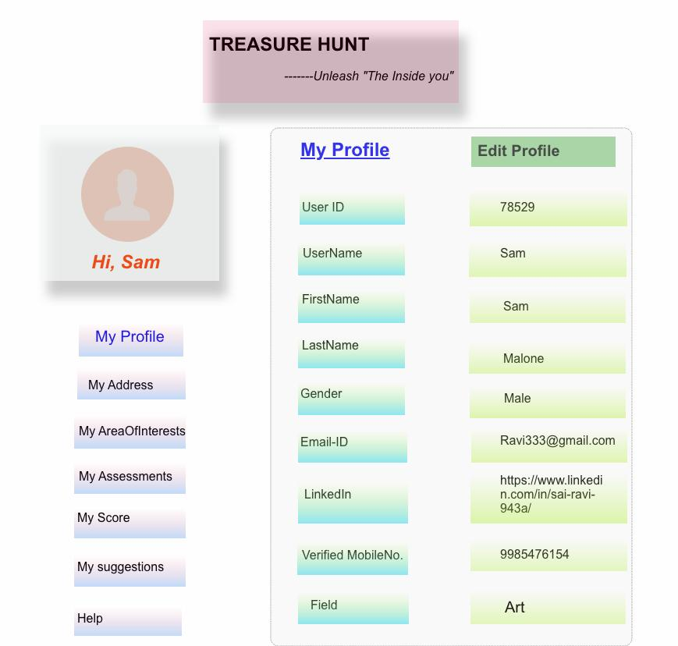

Slide 12
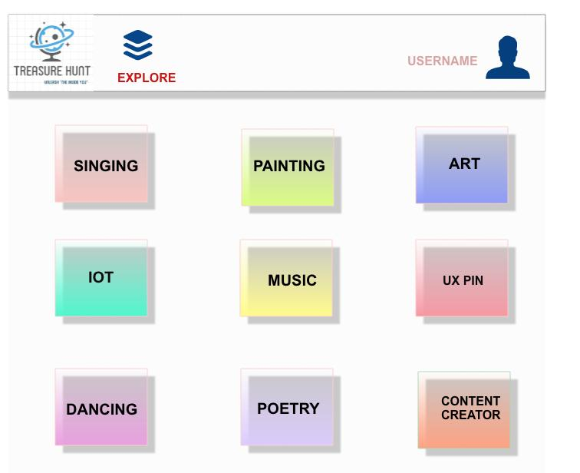

Slide 13
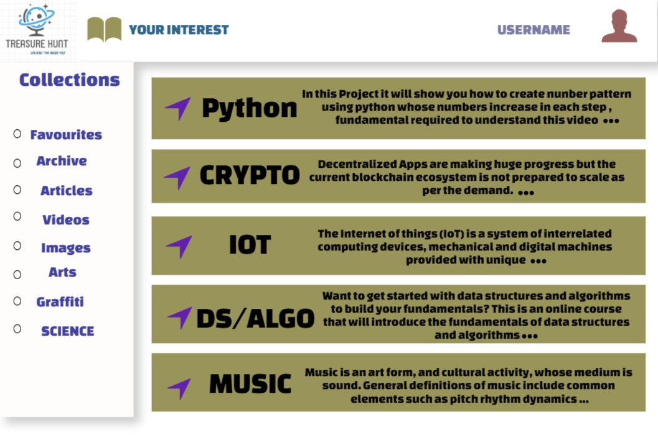

Slide 14
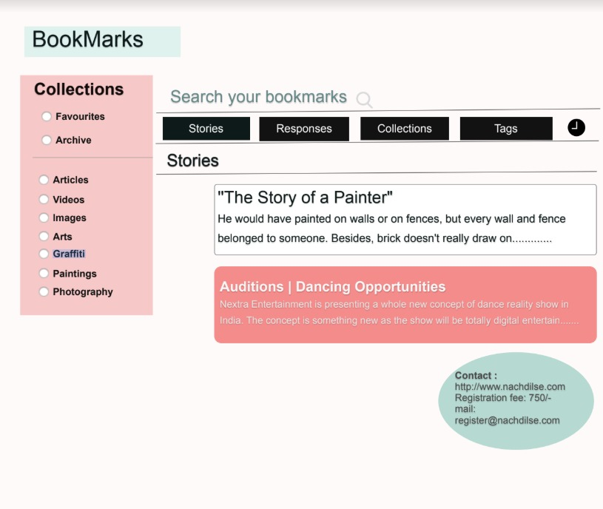

Slide 15
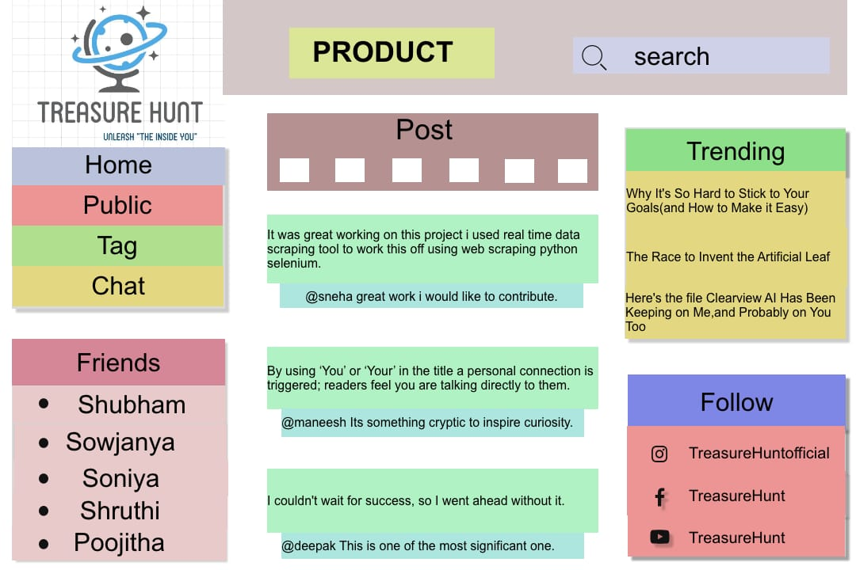

Slide 16
Identifying and developing top talent should start as soon as possible; waiting too long could mean it goes waste – or worse, key individuals could end up feeling undervalued and look at moving on to new opportunities. Instead, recognizing the value in workers early will mean that everyone can reap the benefits.
Although it is important to develop key individuals, the best way to unleash the talent of the team as a whole is to adopt a ‘growth mindset’, both with existing employees and in the company’s approach to recruitment. Having a strong growth mindset is all about fostering a mentality that every team member (rather than just a select few) has talent and innate skills worthy of development.

Slide 17
We all know the main objective of a community is to provide a sense of enjoyment, therefore you’re perhaps unsurprised to hear that gamification helps employees unleash their imagination and creativity.
A by-product of this immersion is the presence of the most elusive psychological state “flow”. Flow is regarded as the optimal performance state, which in turn could help workplace productivity reach an all time high.
Assess key employee competencies
TEST
PROJECT
COMMUNITY
INTEREST
INITIATE FLOW STATES
Gamification allows for greater flexibility within work-related practices. Consequently, candidate can engage in more meaningful work which provides a greater sense of autonomy and fulfilment.
Once candidate start enjoying the task. It means that was his talent to discover.

Slide 18
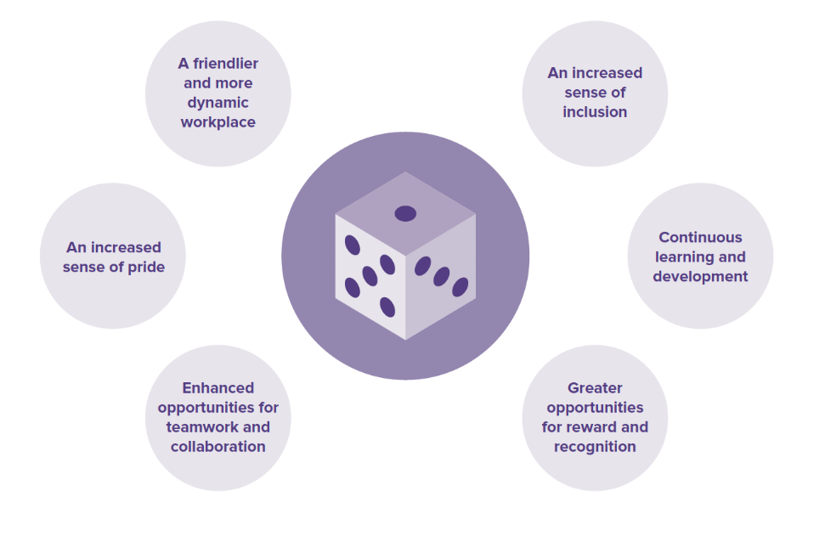
Key points that will Unleash the Hidden Talents

Slide 19
Motivation
Personality Test
Provide a Community
Strategic Projects
Analyzation
Figure out Strengths & Weakness
OUTCOMES:
Step outside of your comfort zone
Suggestions

Slide 20
WIRED FEATURES:

Slide 21
WIRED FEATURES:

Slide 22
IMPACT
max growth
Candidate can gain maximum confidence and can identify his/her new talent to showcase.

Slide 23
THANK YOU
THANK YOU
GROUP 1 , TEAM 16
SONIYA ANKAM
SHUBHAM PATEL
POOJITHA SHATRASI
GUDIKADI SHRUTHI
SOWJANYA UNGRALA

